Slide 1
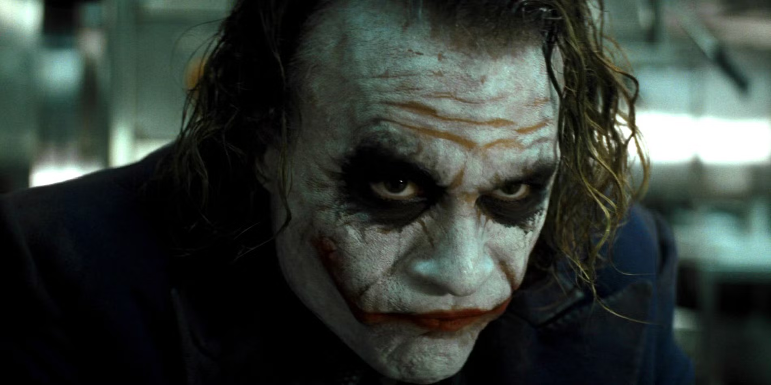
Notes:
The joker

Slide 2
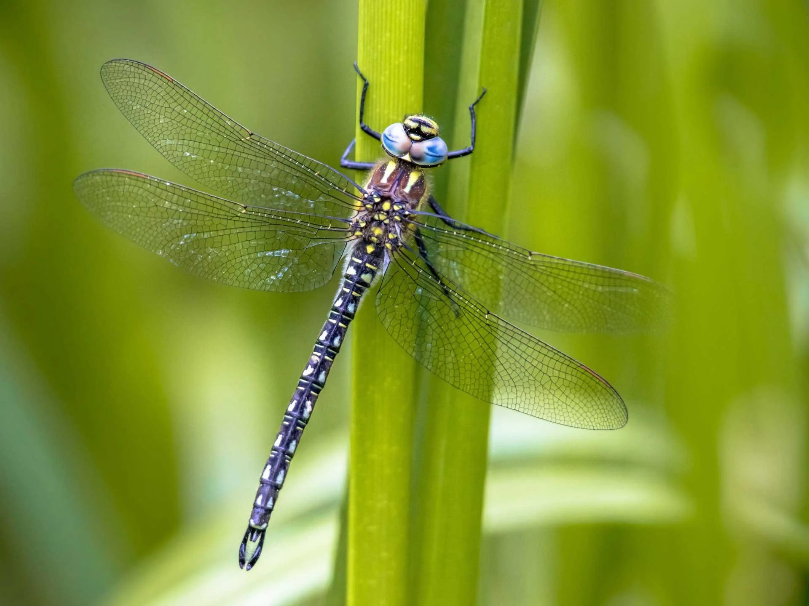
Notes:
dragonfly

Slide 3
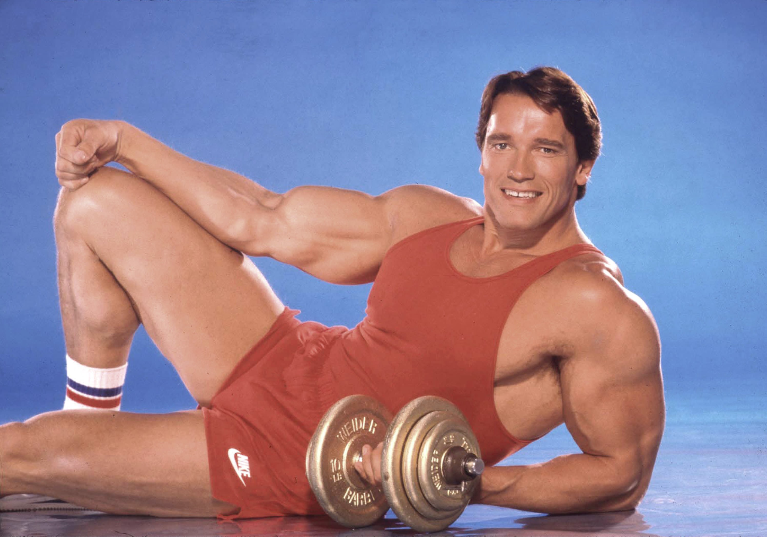
Notes:
Arnold Schwarzenegger

Slide 4
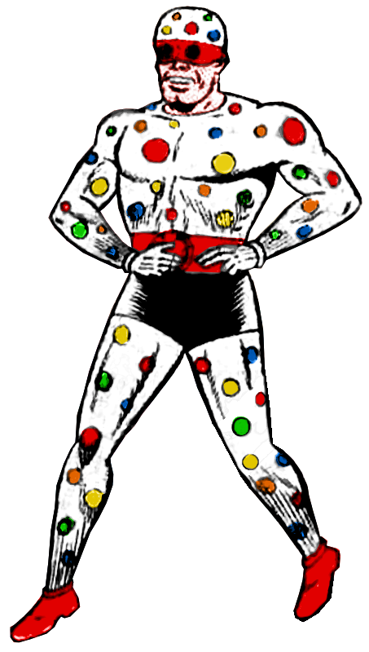
Notes:
Polka dot man

Slide 5
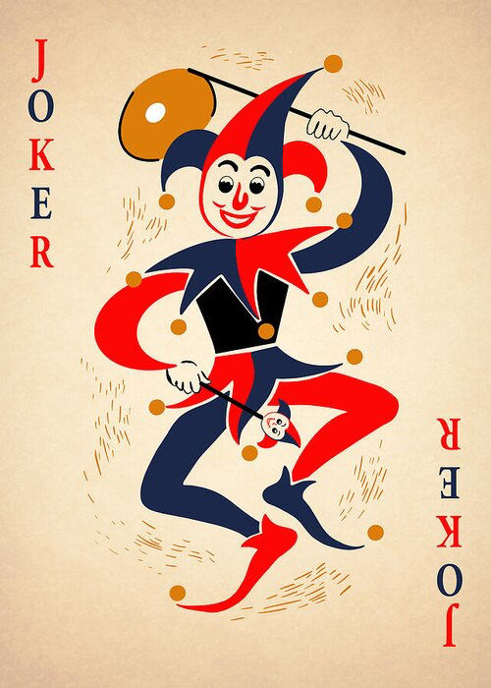
Notes:
Joker

Slide 6
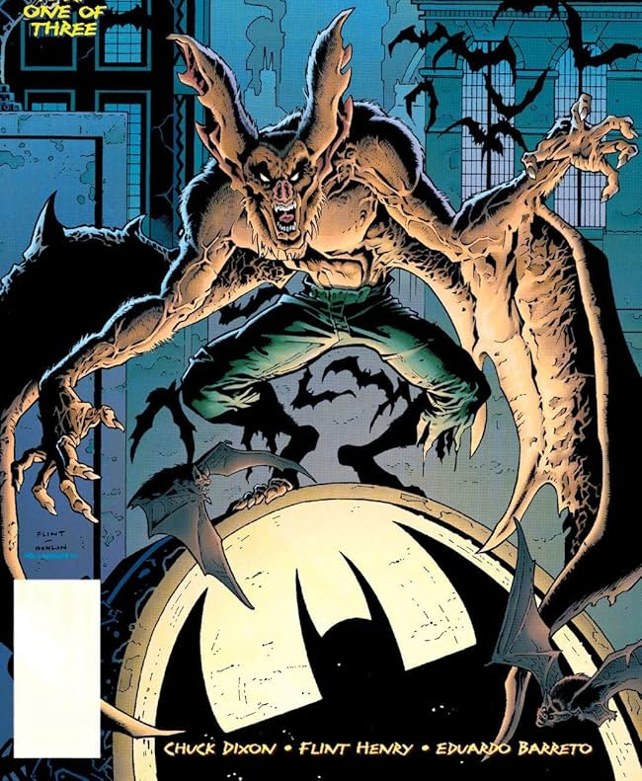
Notes:
man-bat

Slide 7
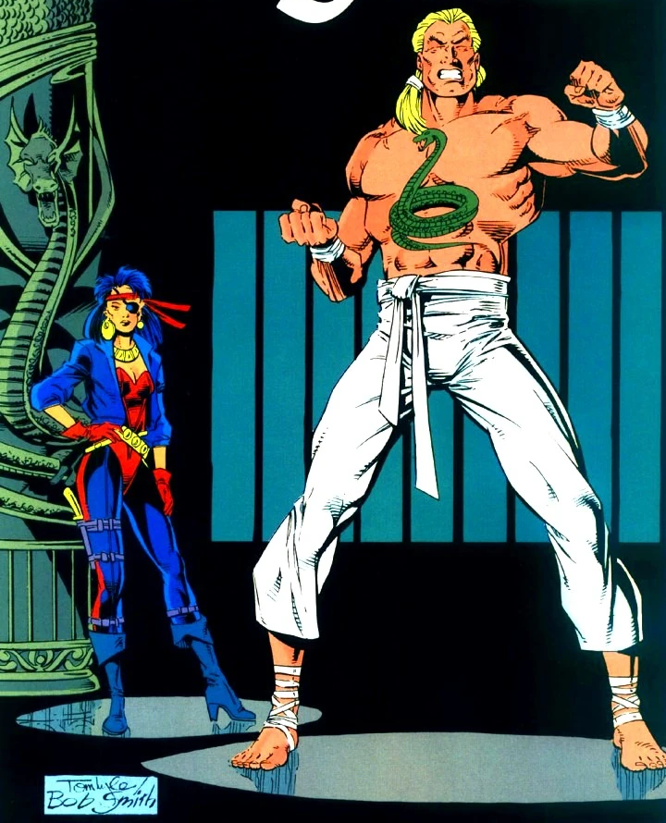
Notes:
King Snake

Slide 8
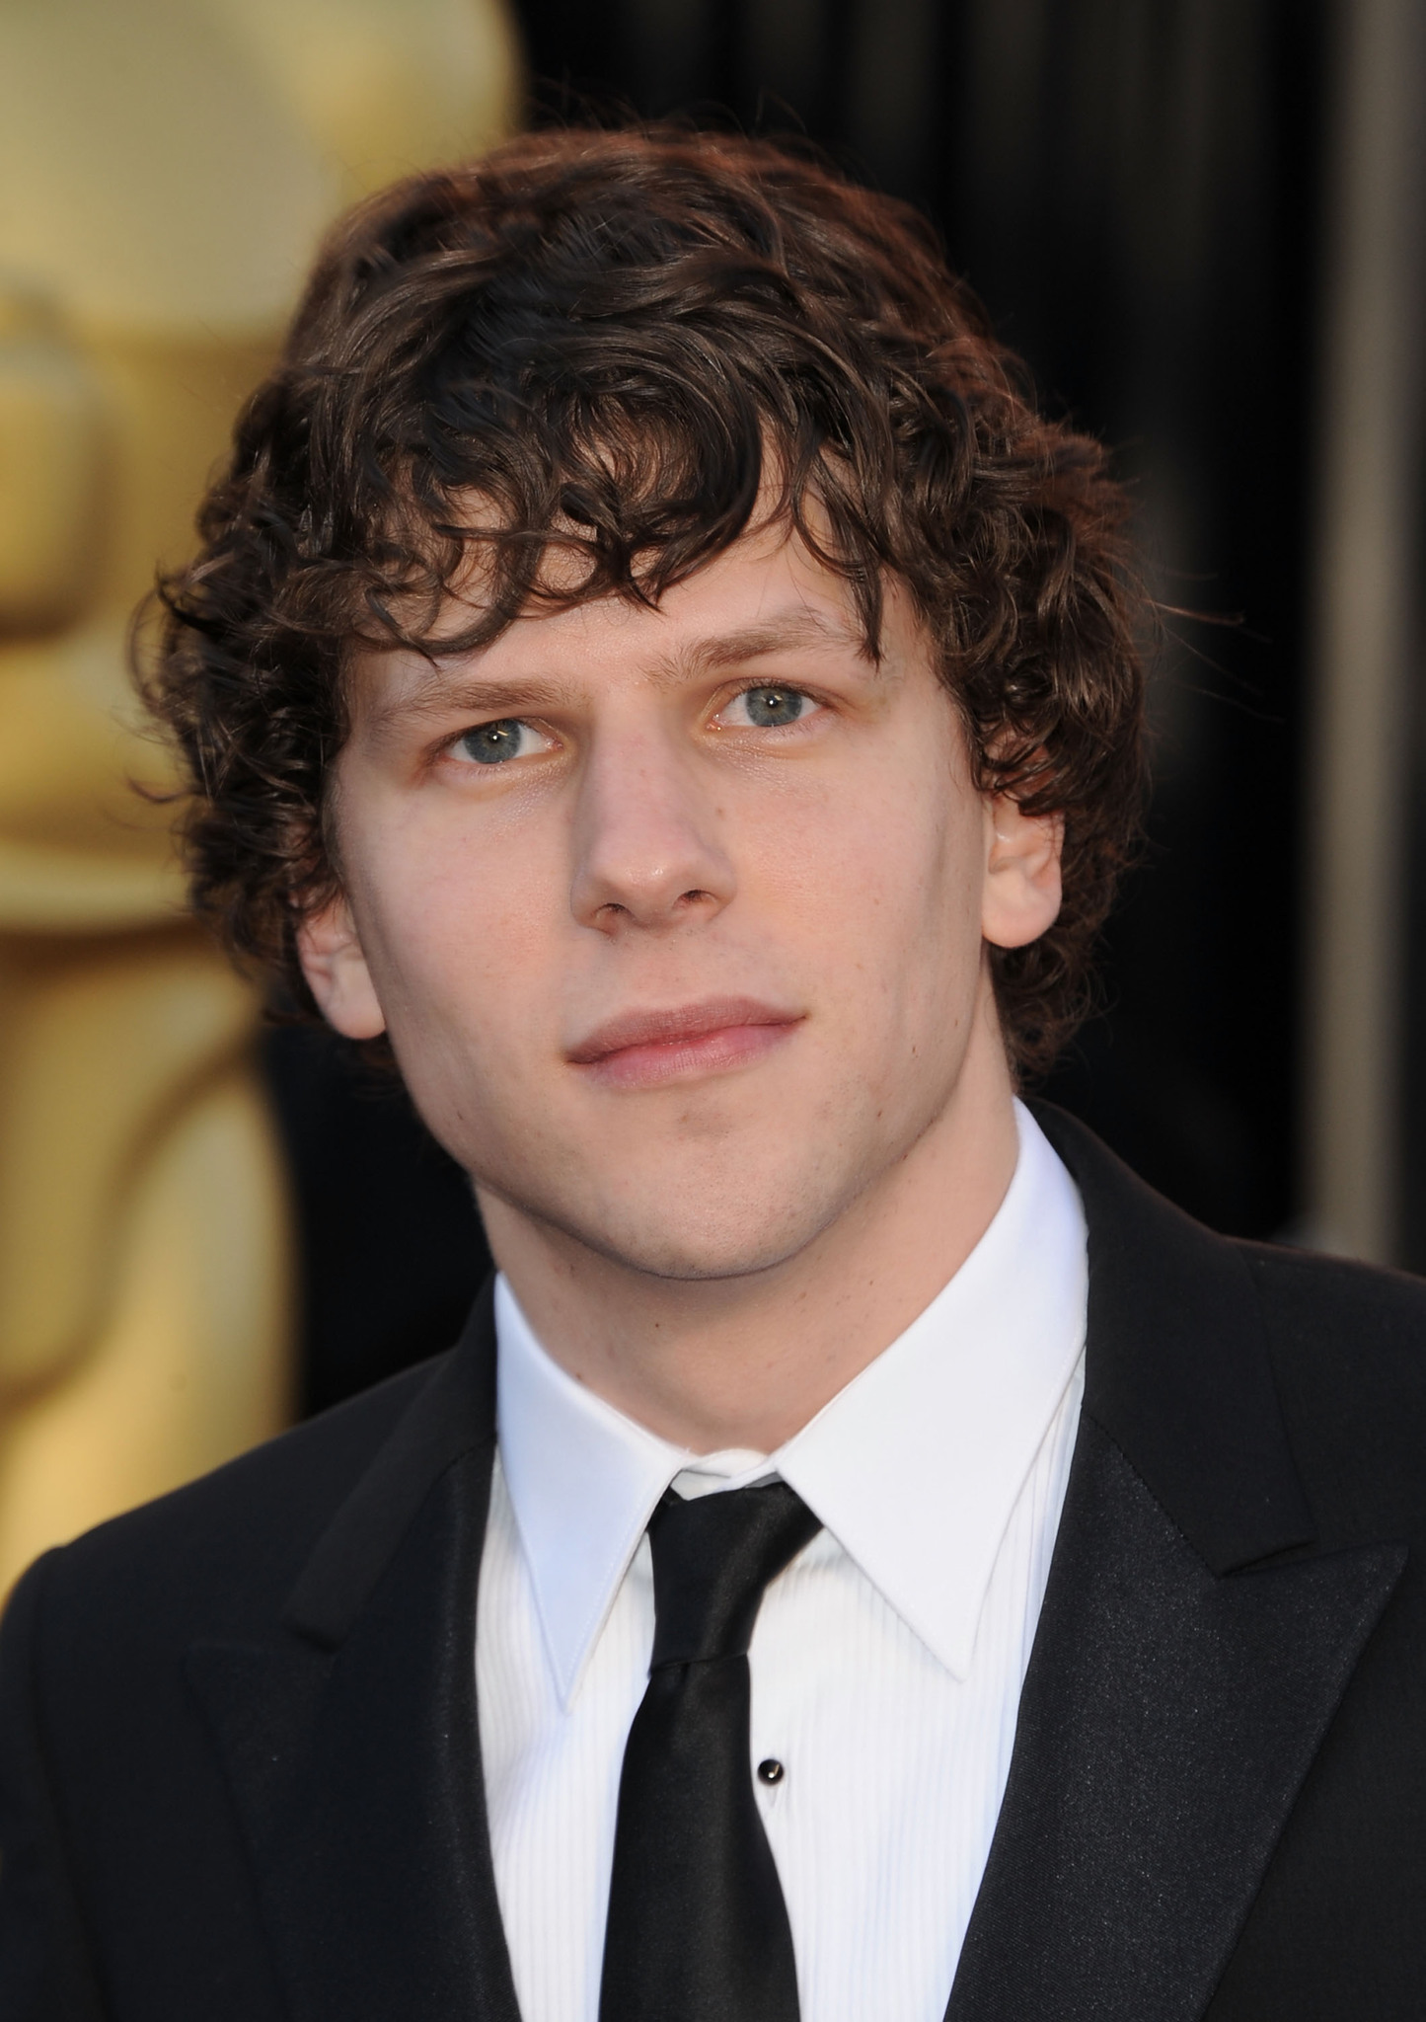
Notes:
Jesse Eisenberg

Slide 9

Notes:
Poison ivy

Slide 10
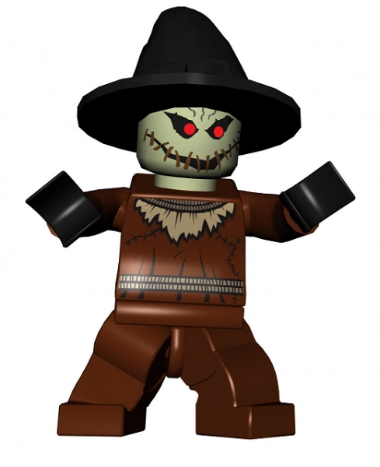
Notes:
Scarecrow

Slide 11
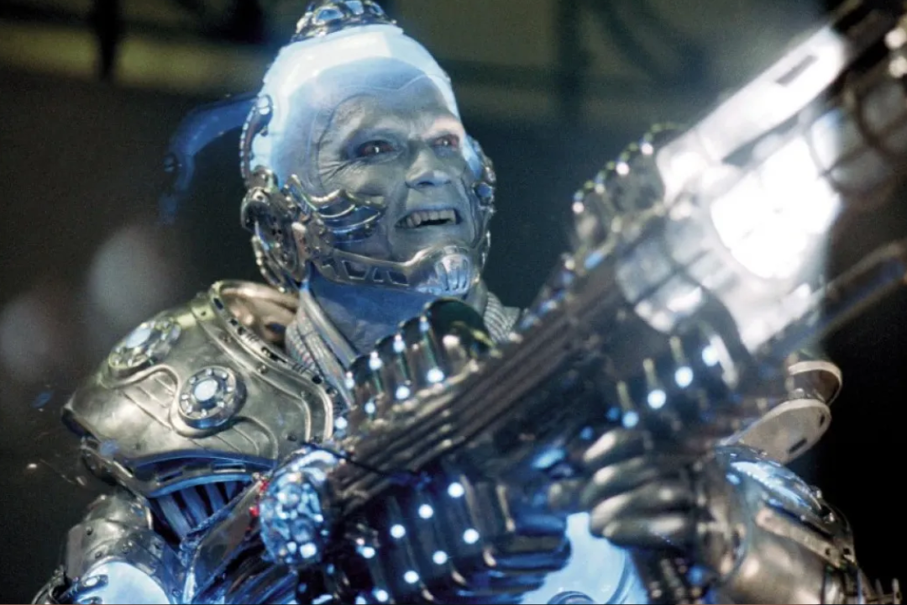
Notes:
Mr Freeze

Slide 12
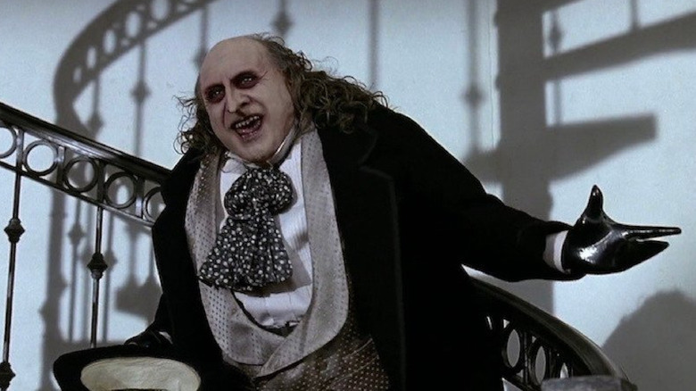
Notes:
The penguin

Slide 13
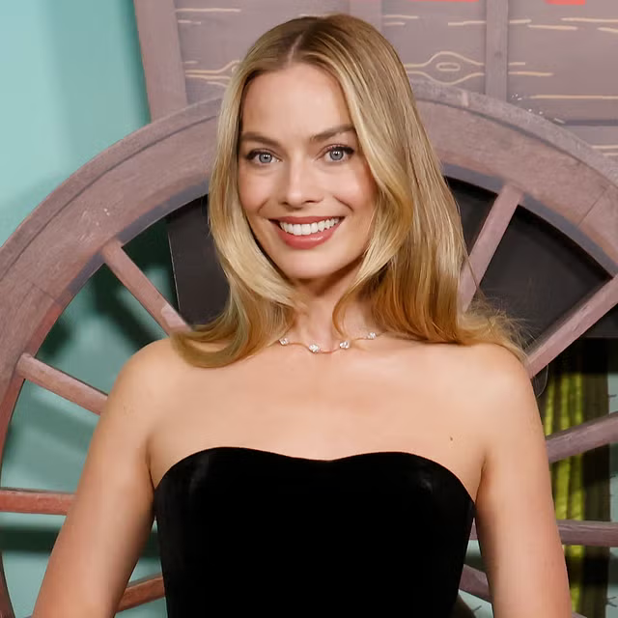
Notes:
Margot Robbie

Slide 14
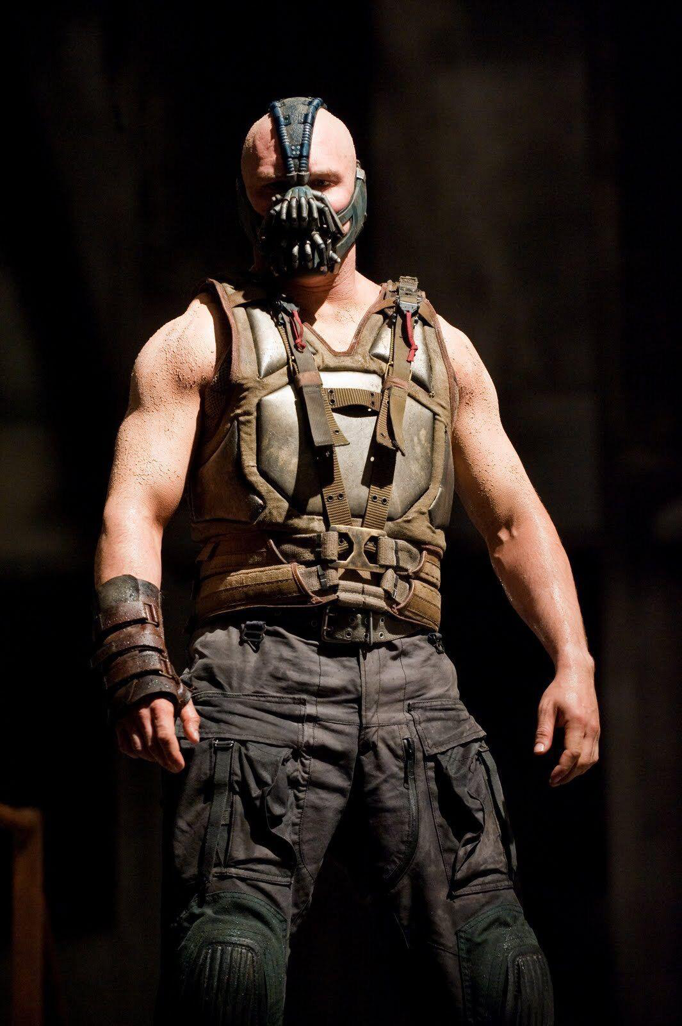
Notes:
Bane

Slide 15
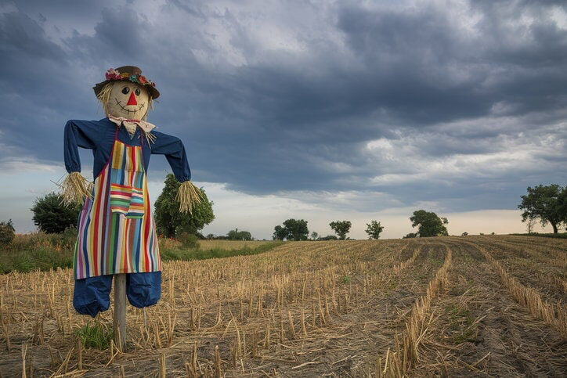
Notes:
scarecrow

Slide 16
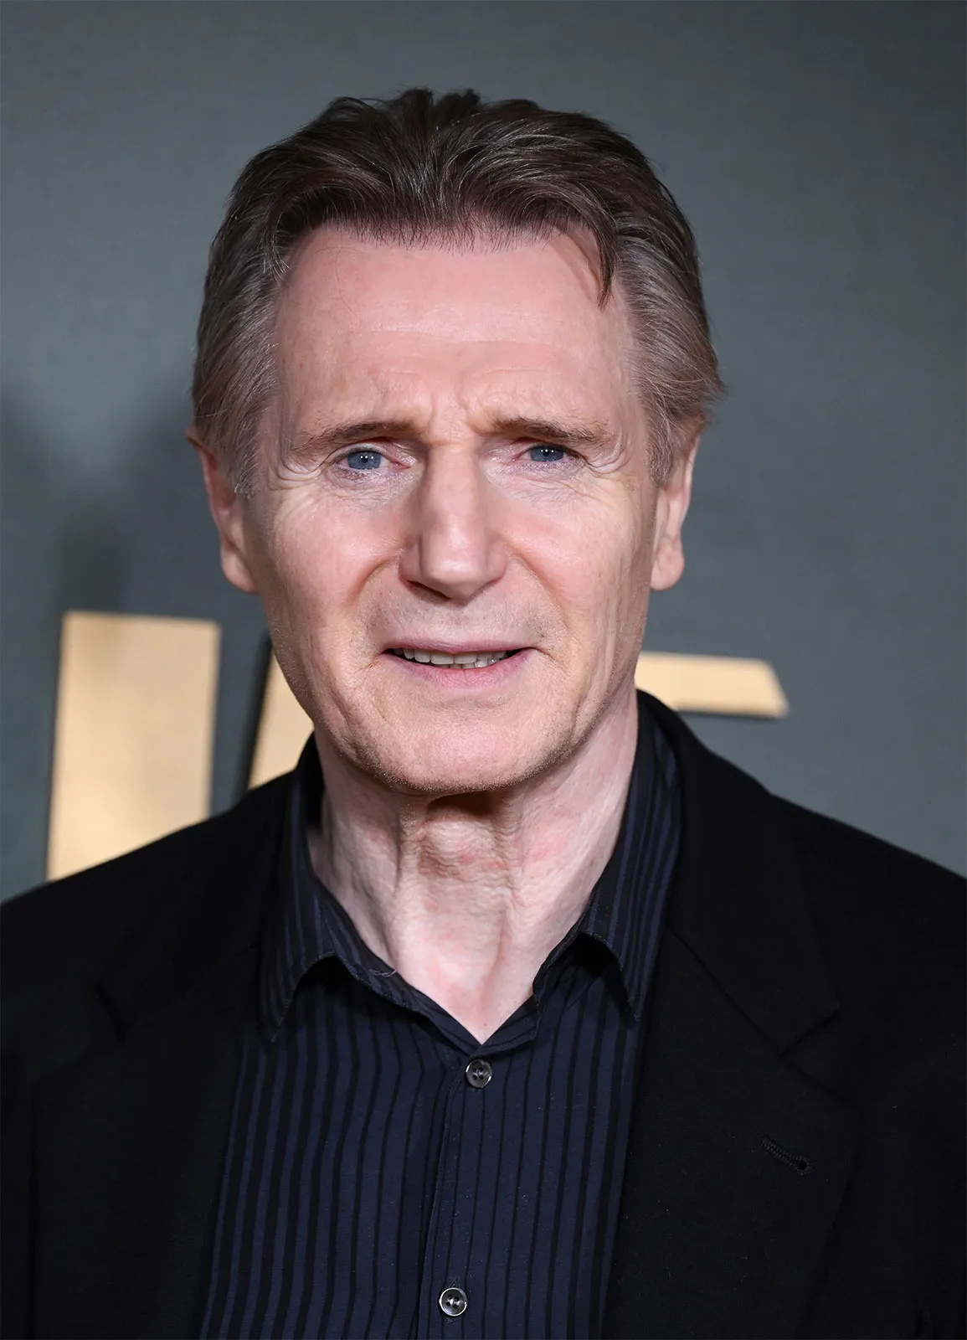
Notes:
Liam Neeson

Slide 17
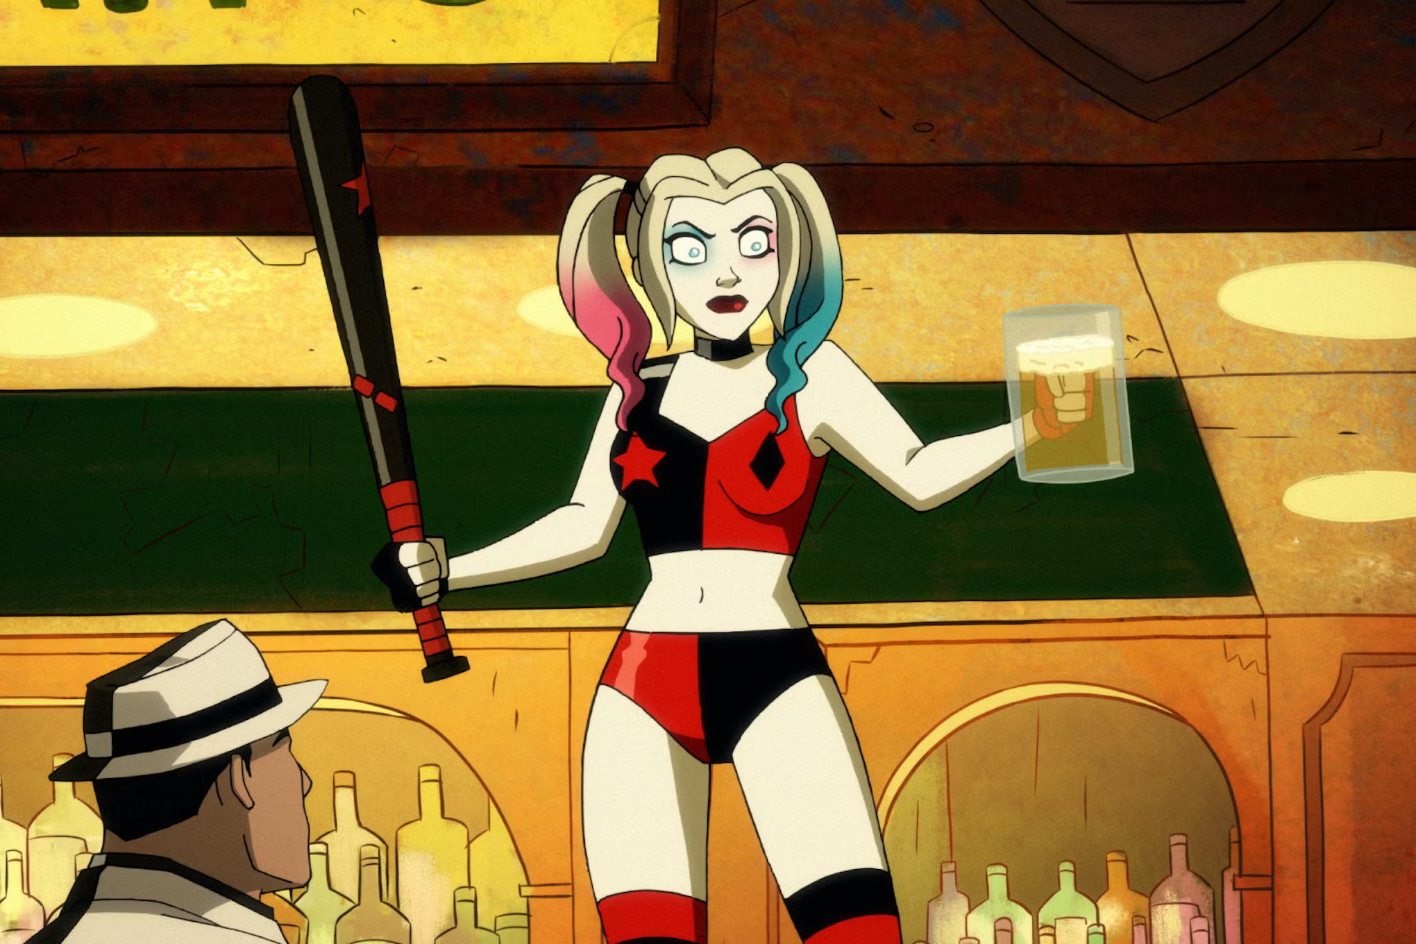
Notes:
Harley Quinn

Slide 18
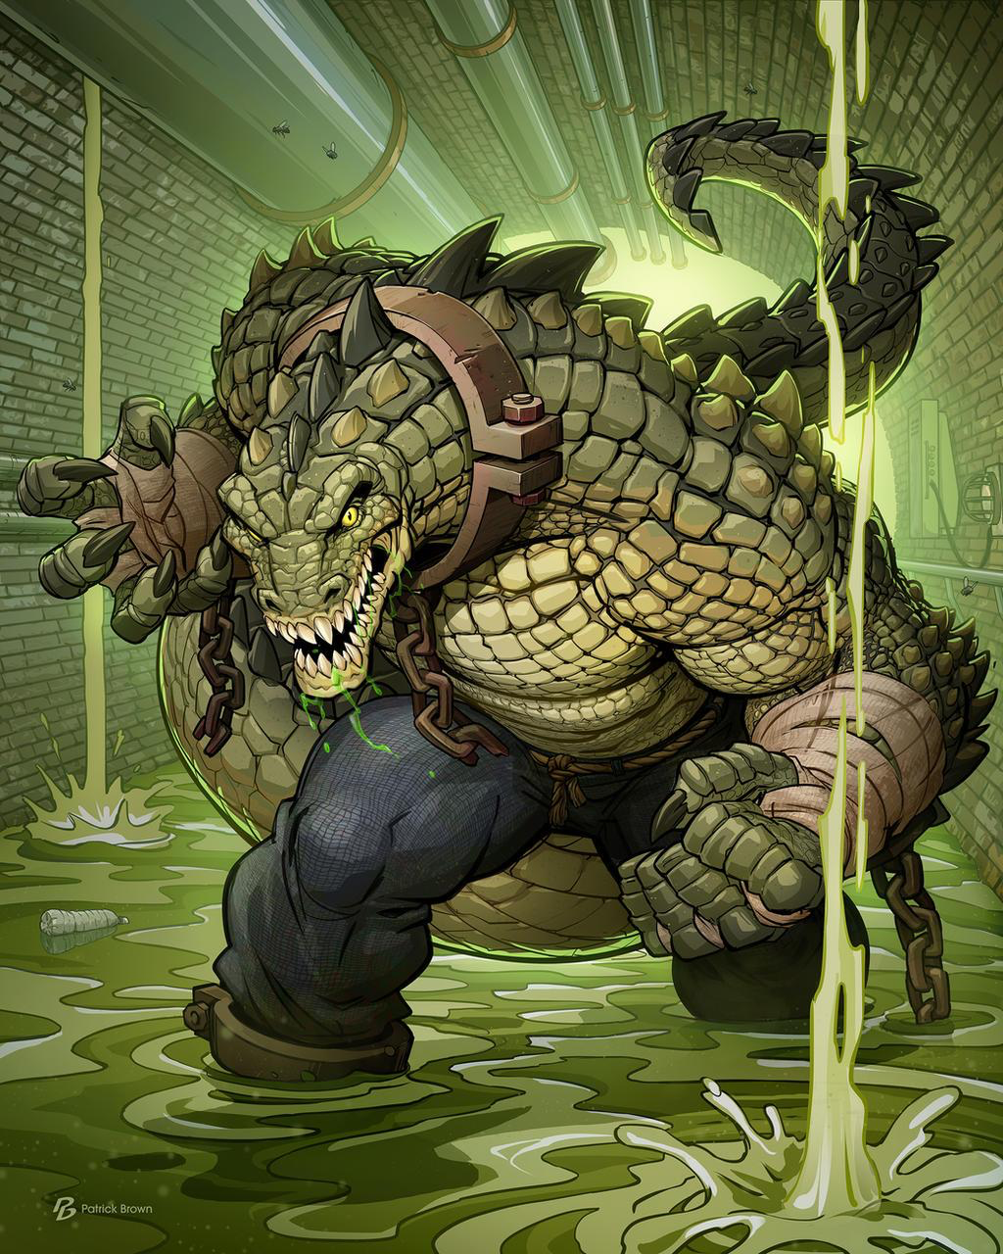
Notes:
Killer Croc

Slide 19
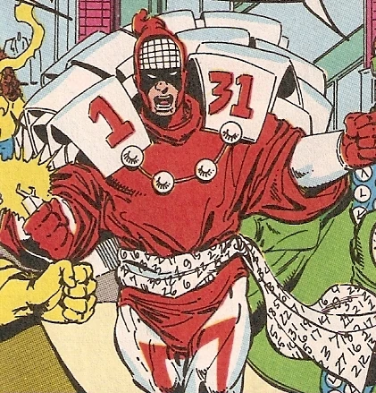
Notes:
Calendar man

Slide 20
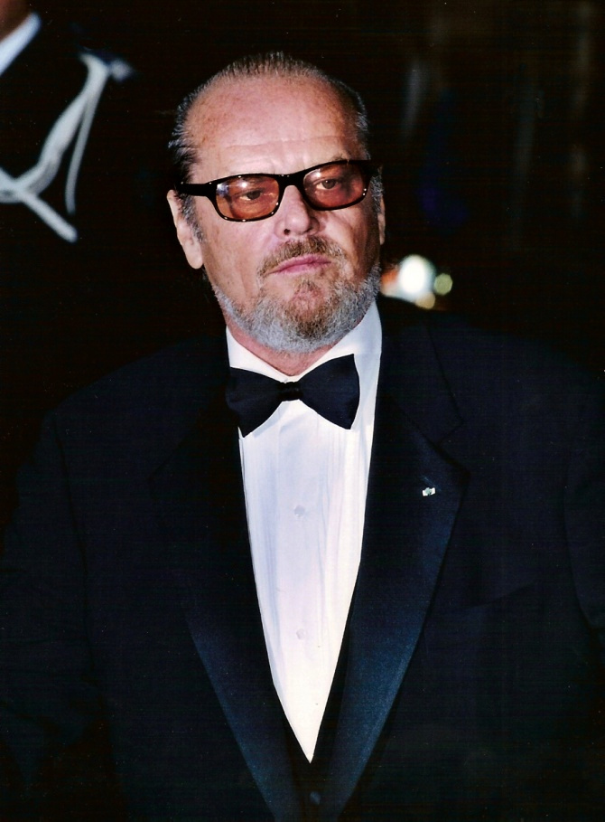
Notes:
Jack Nicholson

Slide 21
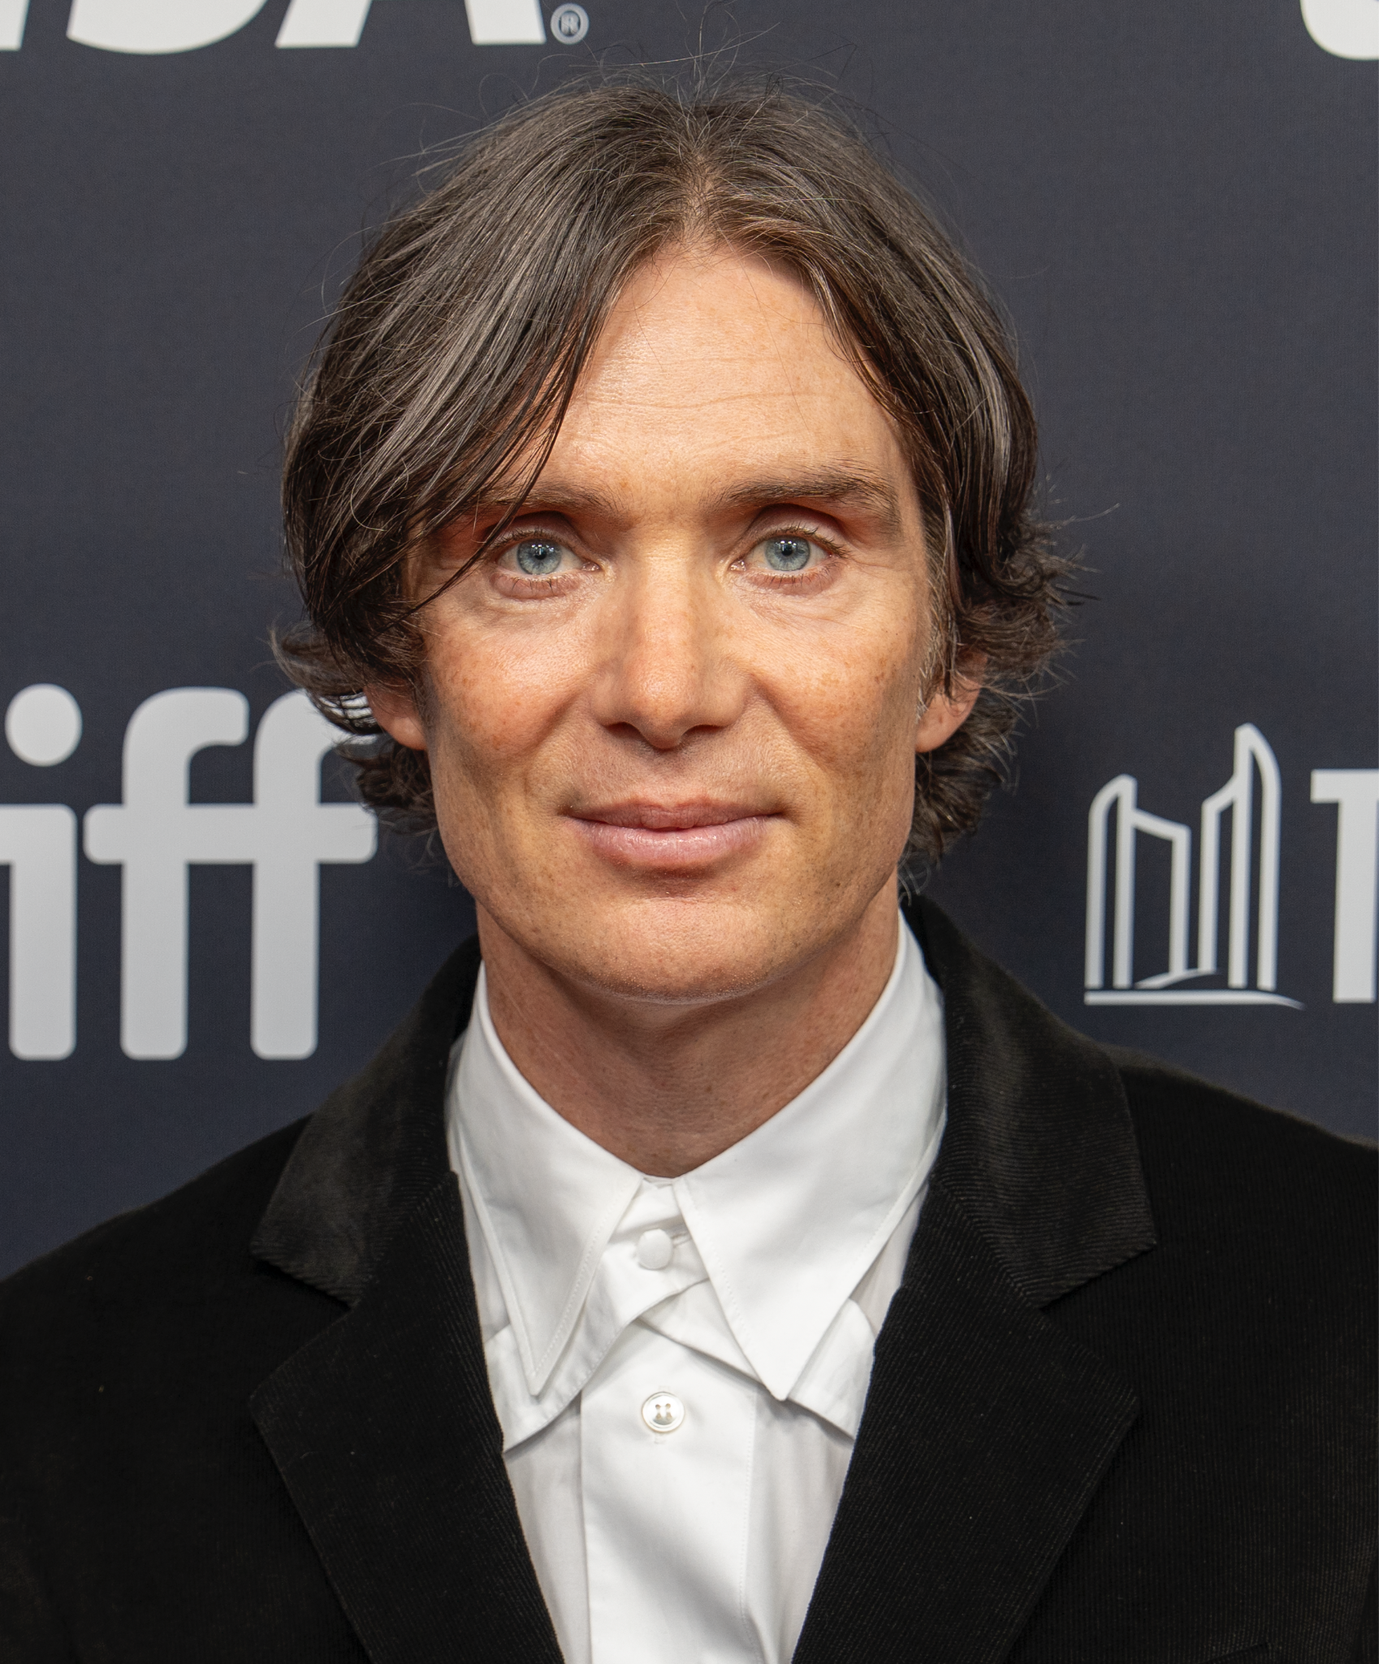
Notes:
Cillian Murphy

Slide 22
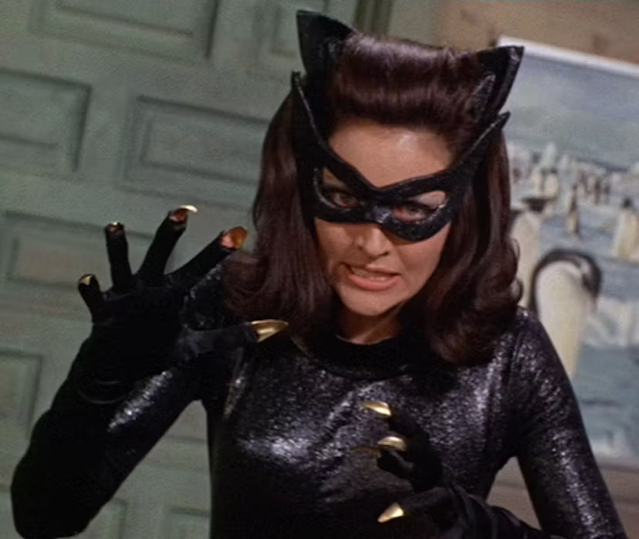
Notes:
Catwoman

Slide 23
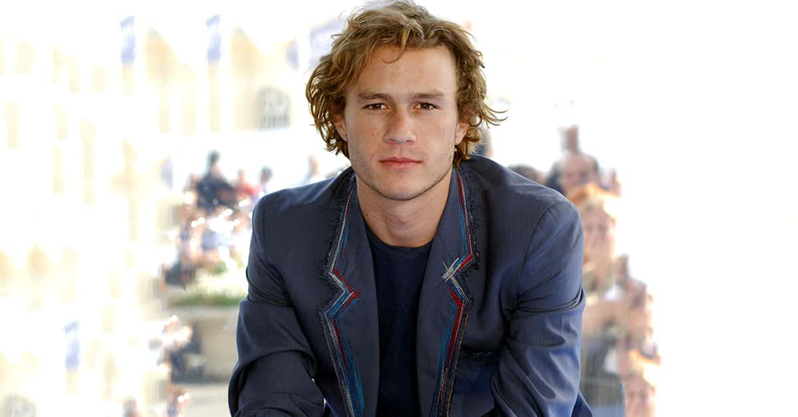
Notes:
Heath Ledger

Slide 24
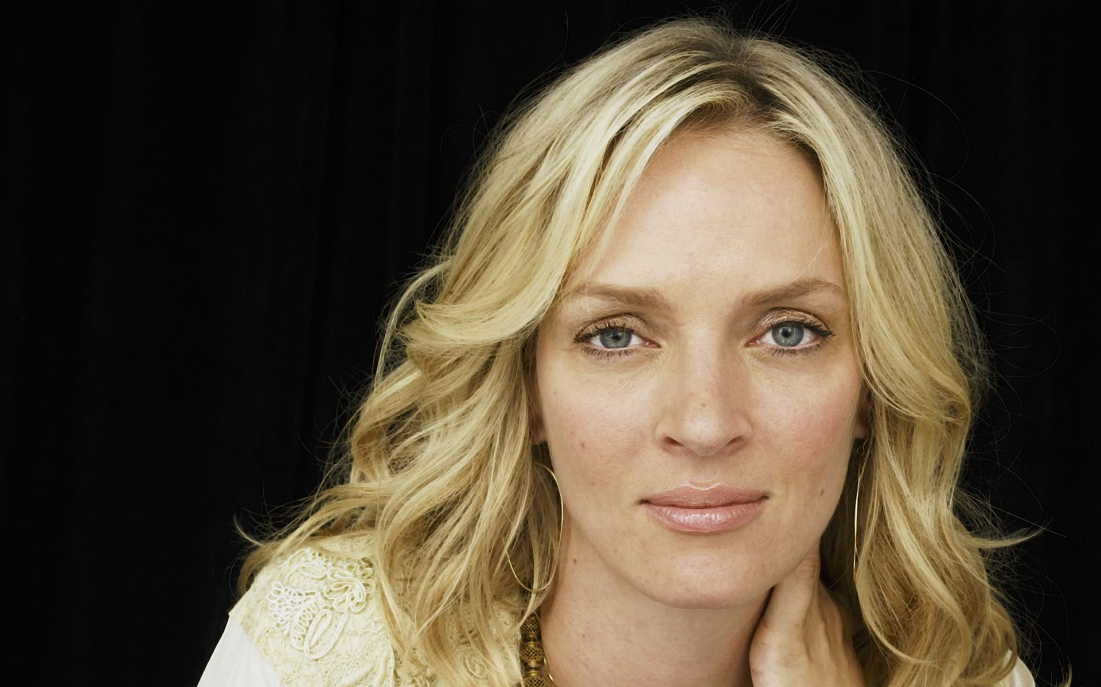
Notes:
Uma Thurman

Slide 25
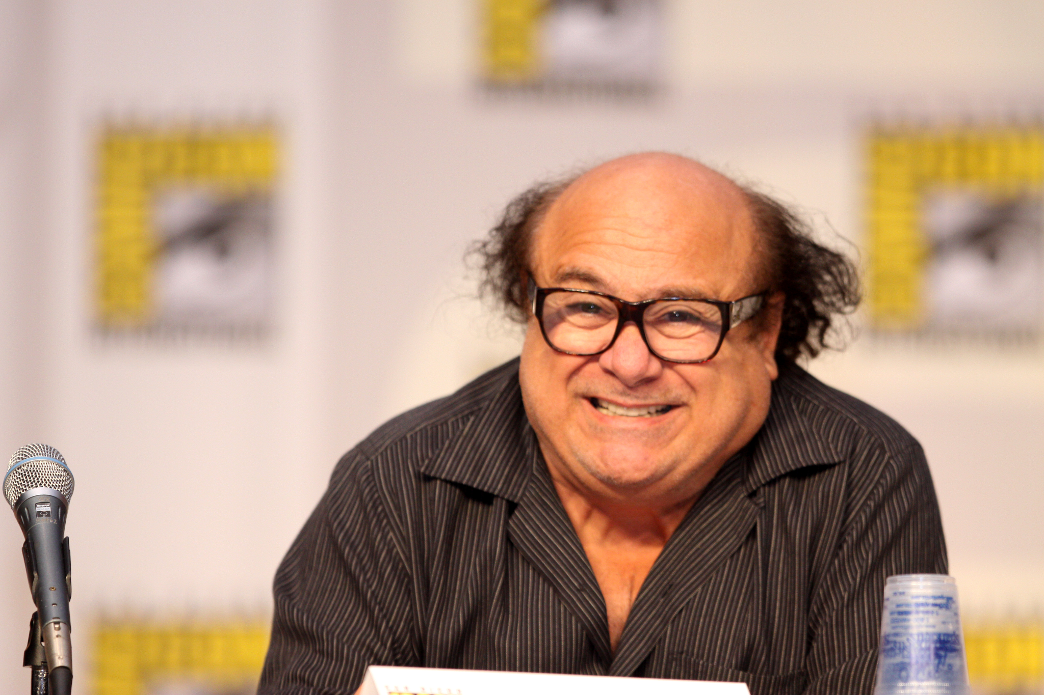
Notes:
Danny Devito

Slide 26
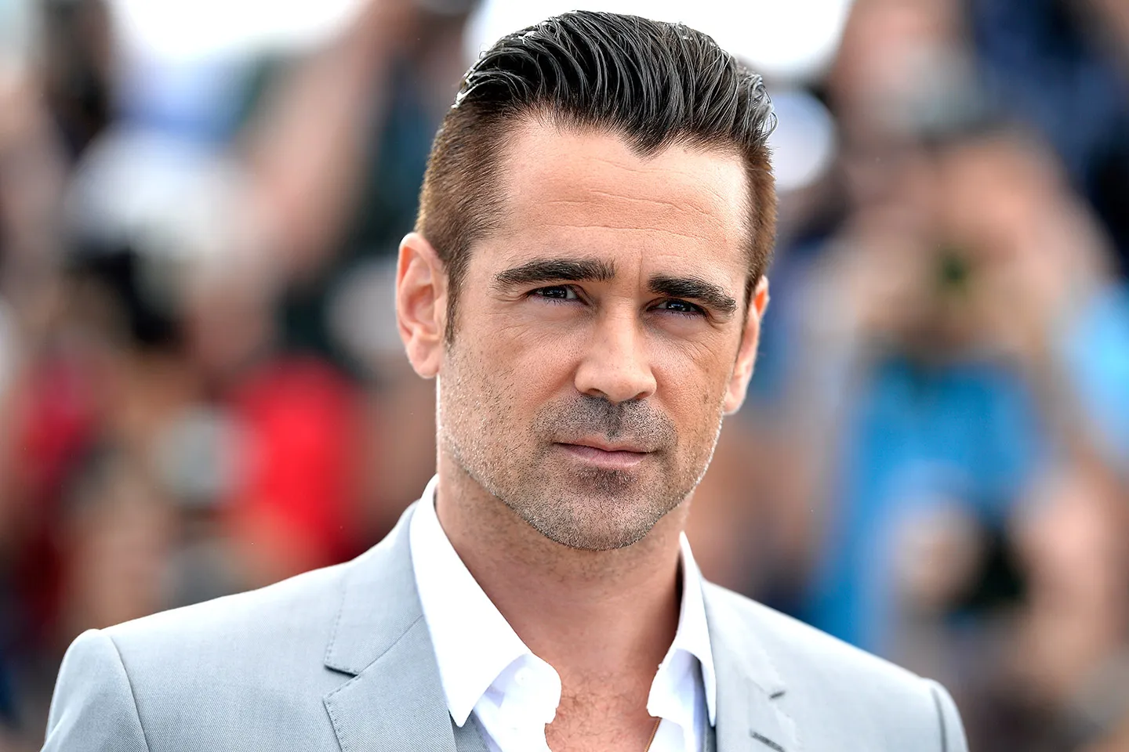
Notes:
Colin Farrel

Slide 27
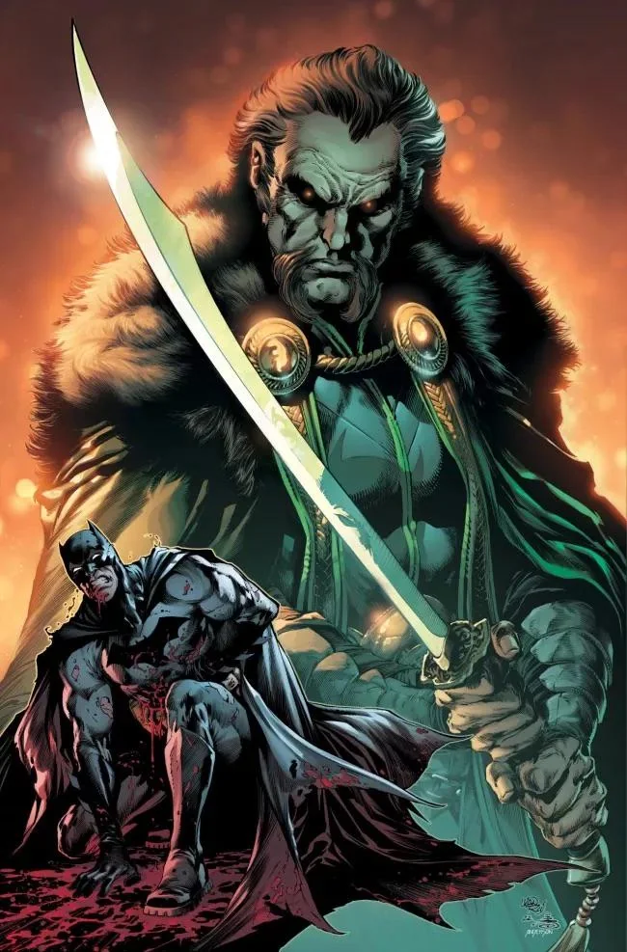
Notes:
Ra’s Al Ghul

Slide 28
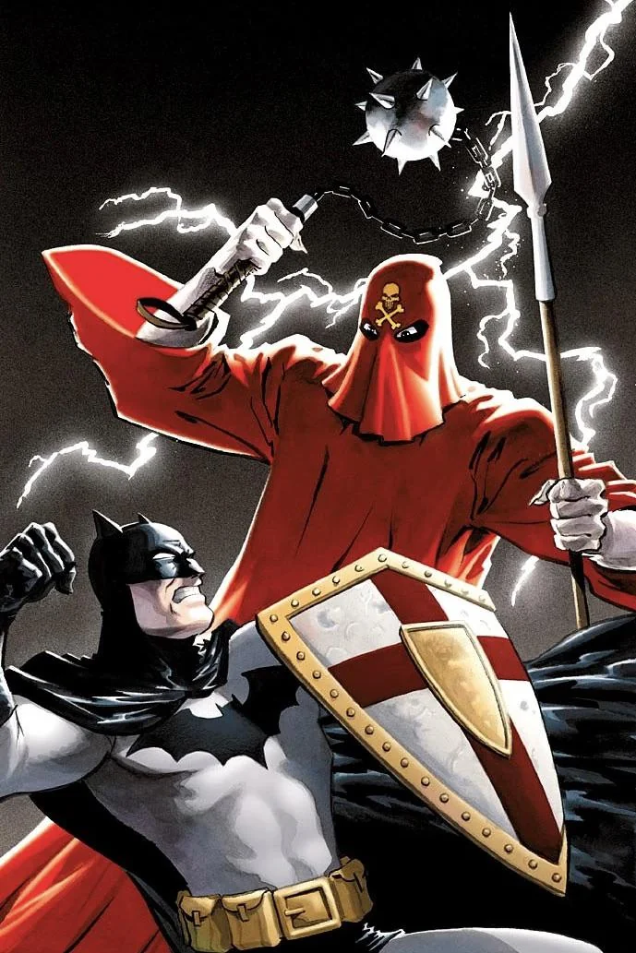
Notes:
The (Mad) Monk

Slide 29
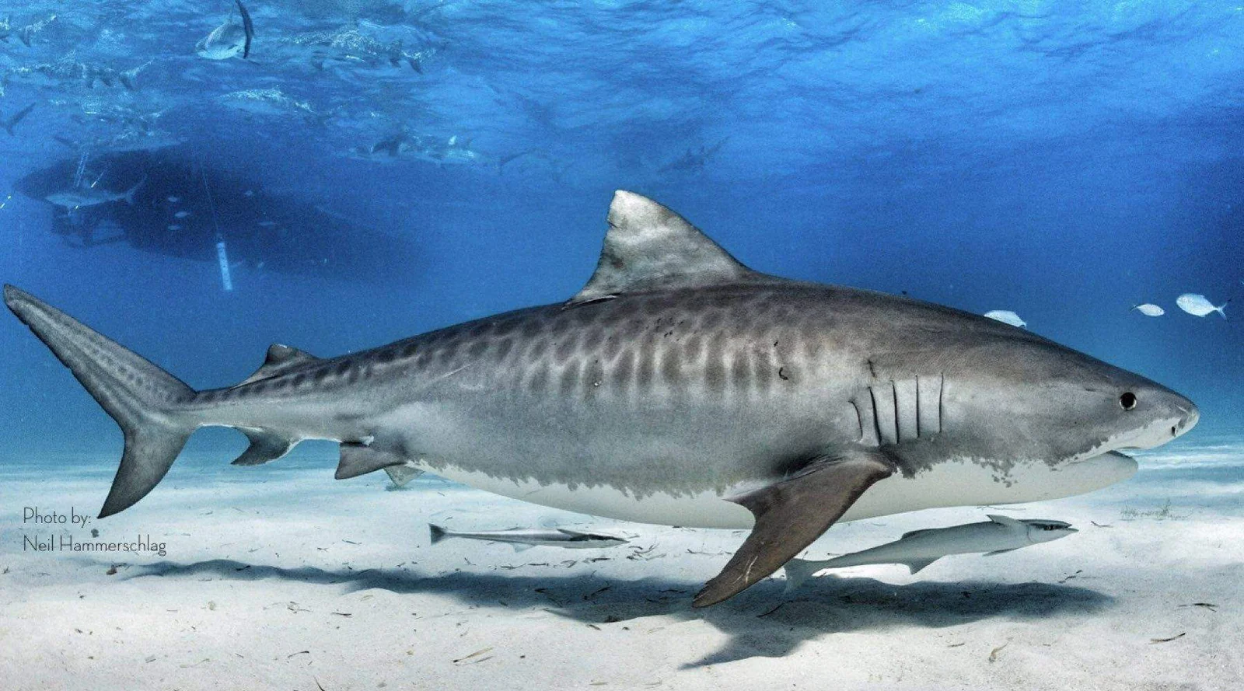
Notes:
Tiger shark

Slide 30
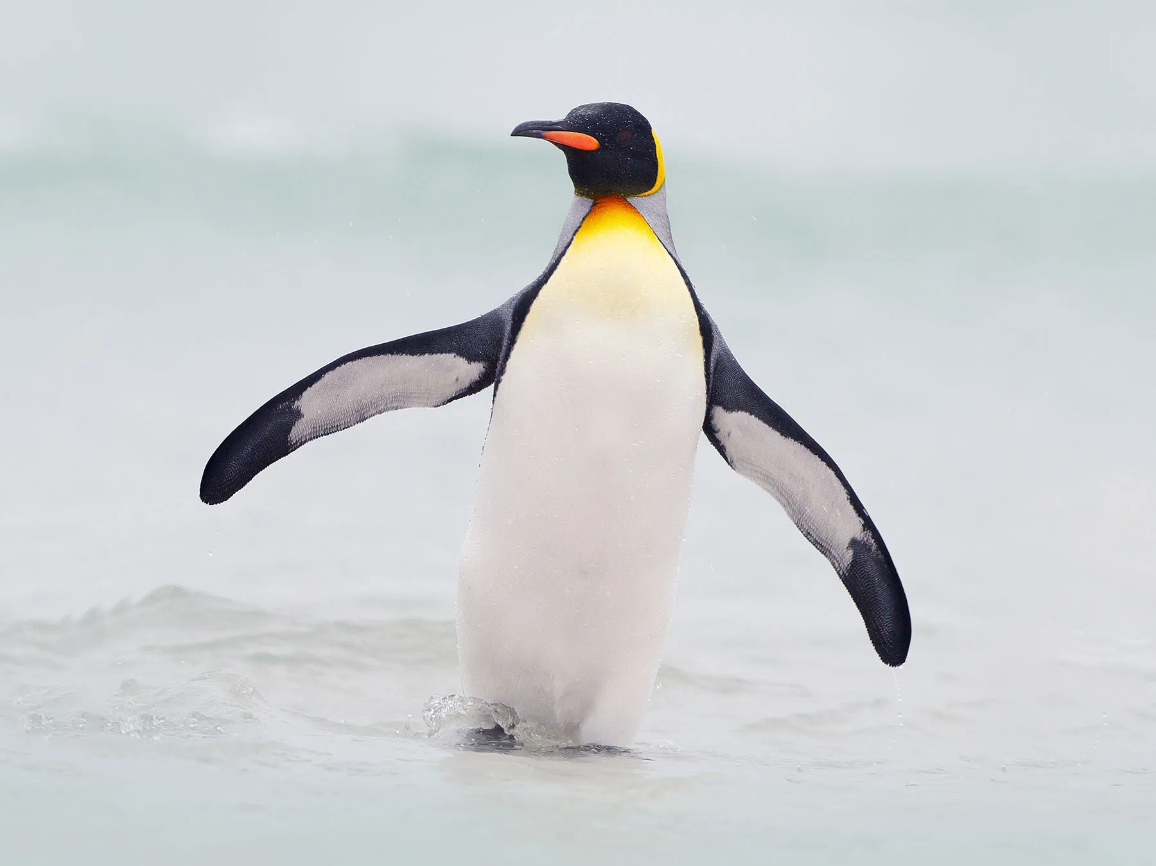
Notes:
penguin

Slide 31
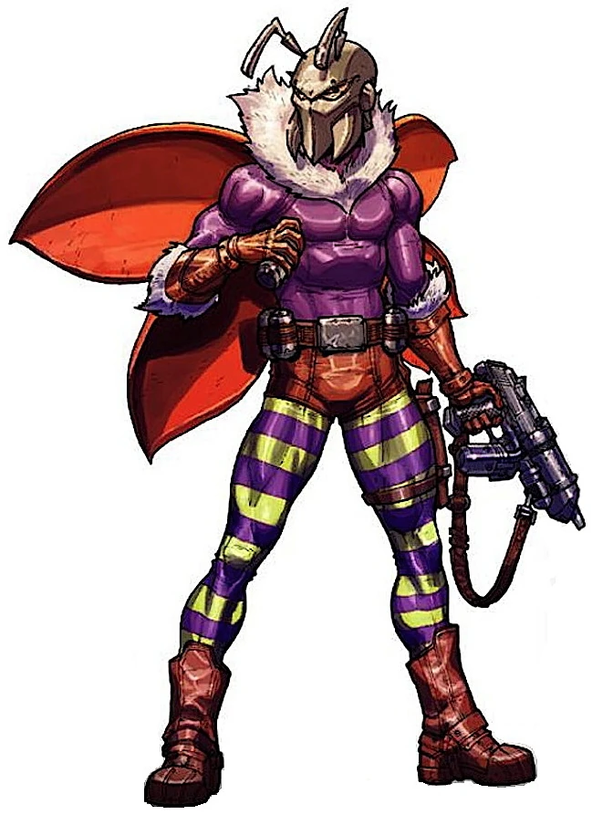
Notes:
Killer moth

Slide 32
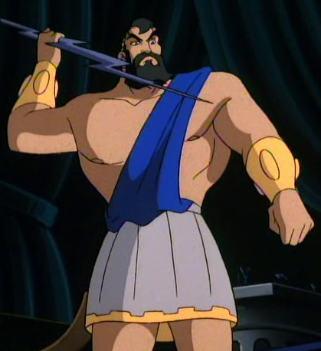
Notes:
Maxie Zeus

Slide 33
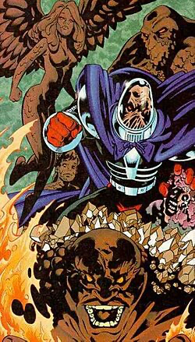
Notes:
Clayface

Slide 34
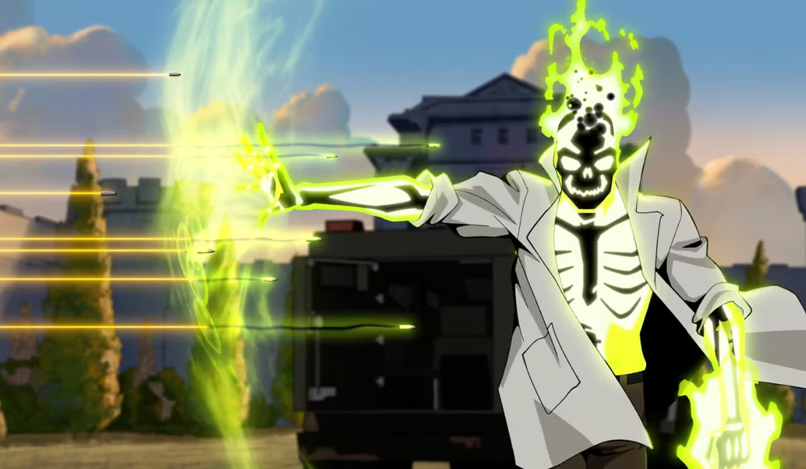
Notes:
Dr Phosphorus

Slide 35
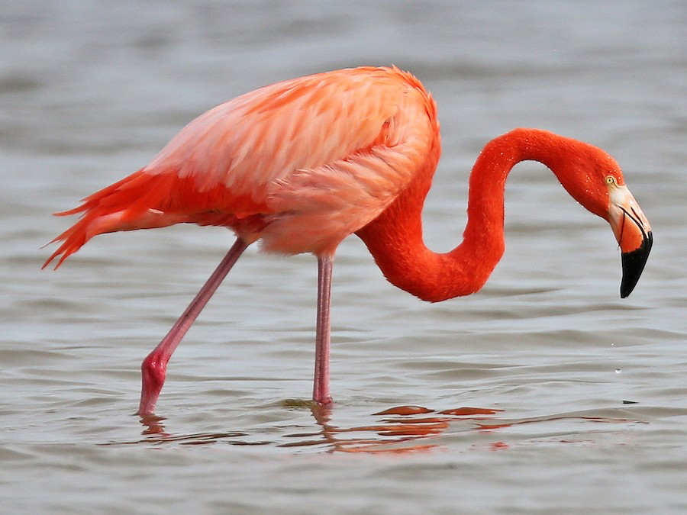
Notes:
flamingo

Slide 36
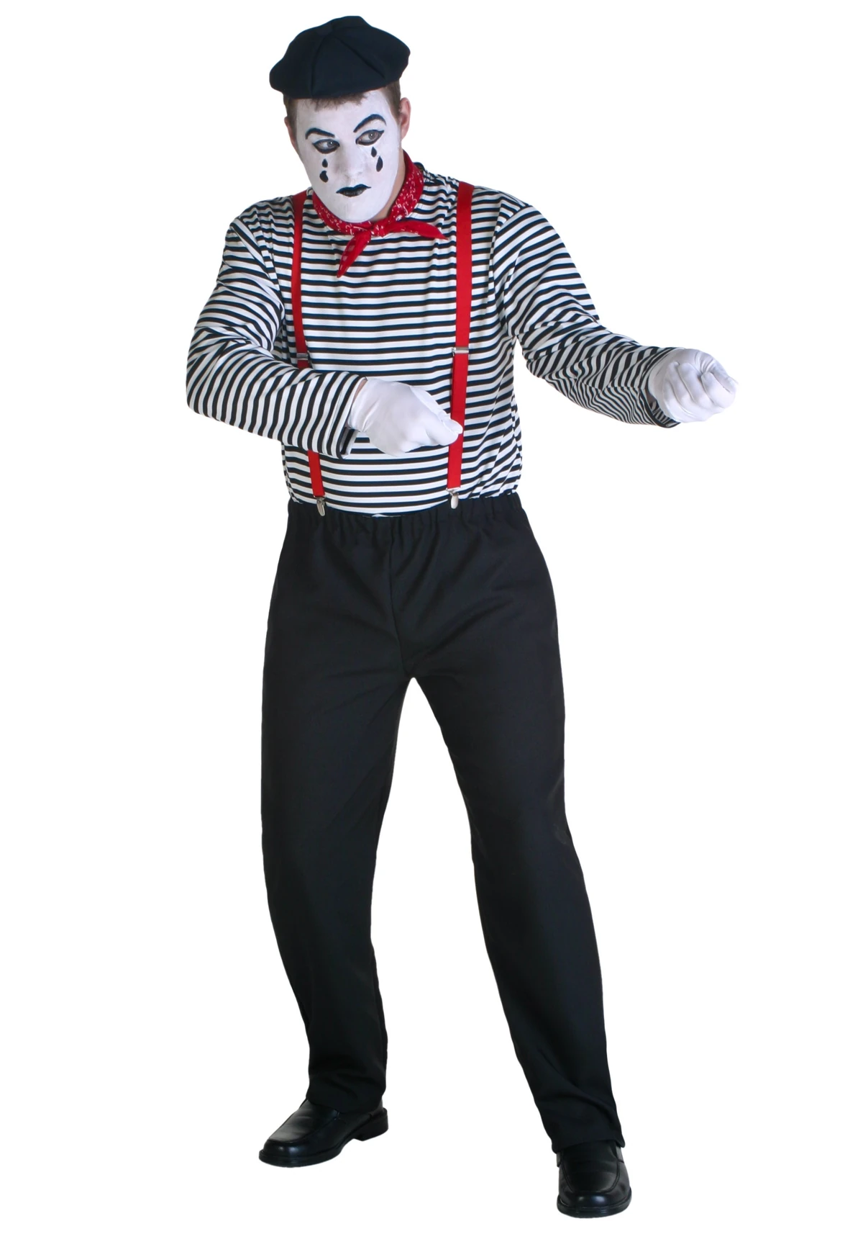
Notes:
mime

Slide 37
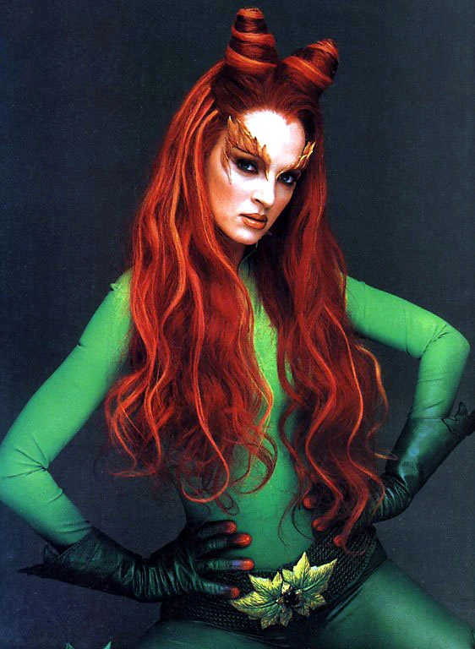
Notes:
Poison ivy

Slide 38
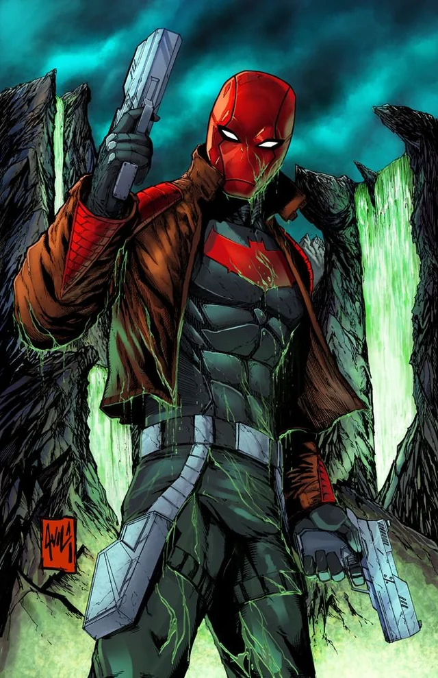
Notes:
Red hood

Slide 39
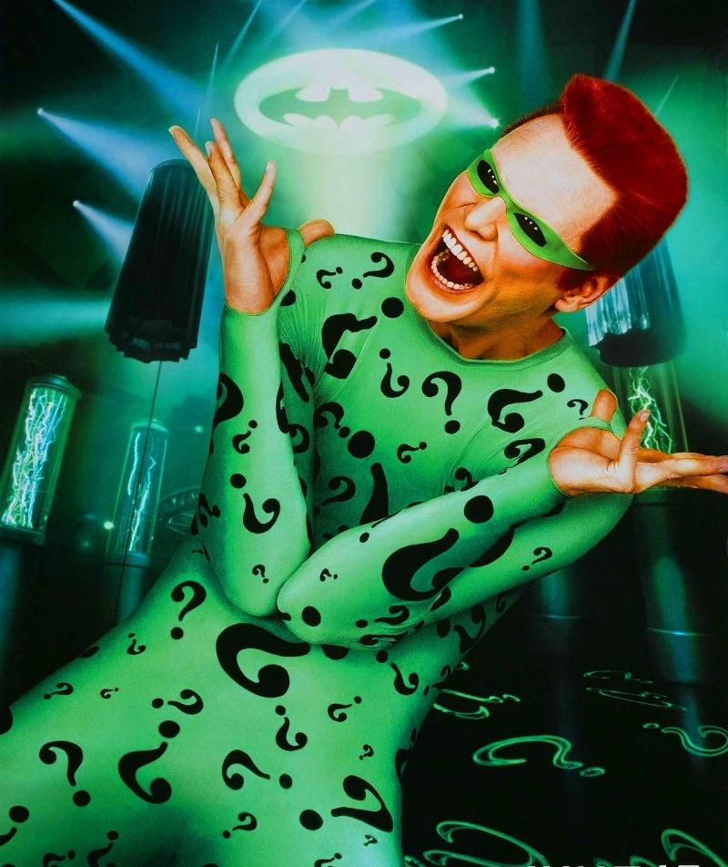
Notes:
The Riddler

Slide 40
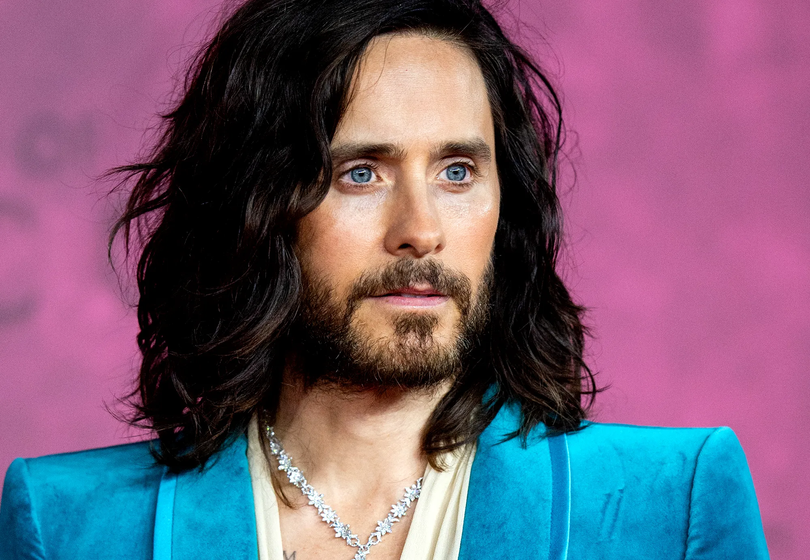
Notes:
Jared Leto

Slide 41
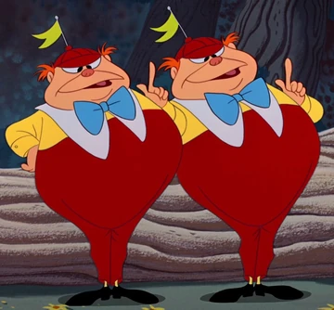
Notes:
Tweedle dee and tweedle dum

Slide 42
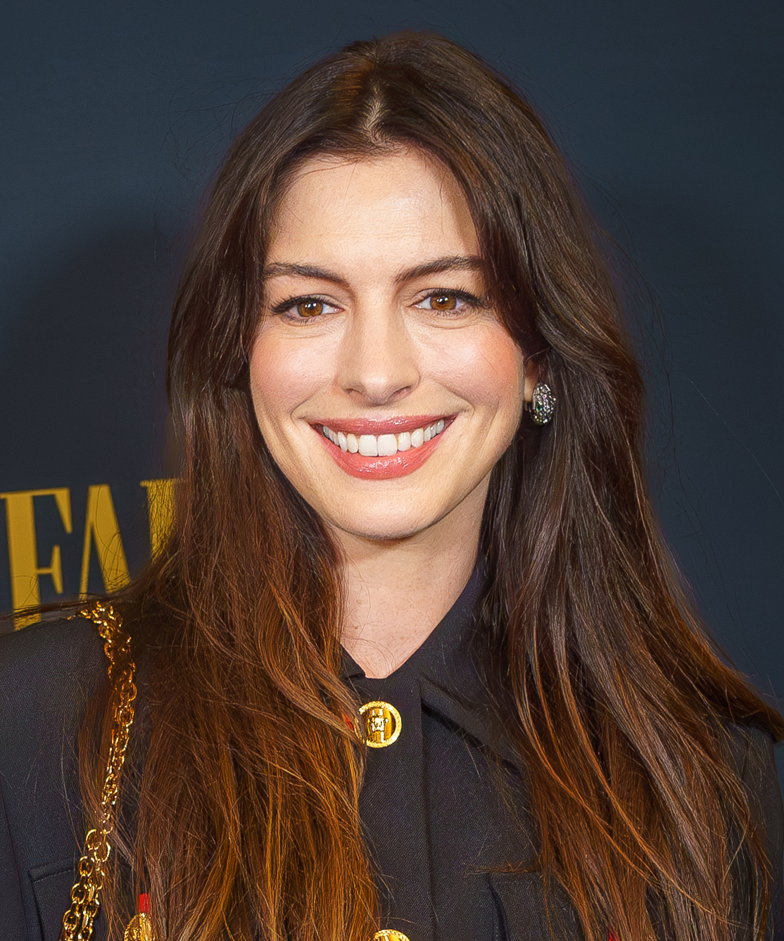
Notes:
Anne Hathaway

Slide 43
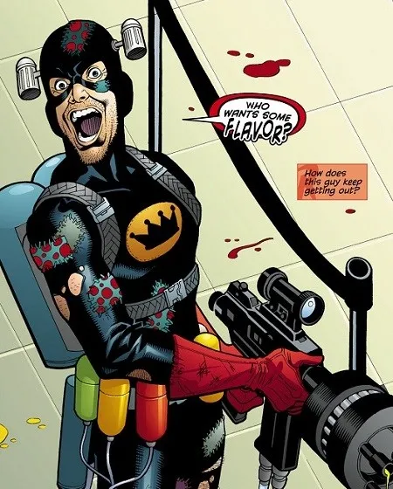
Notes:
Condiment king

Slide 44
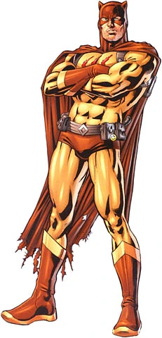
Notes:
catman

Slide 45
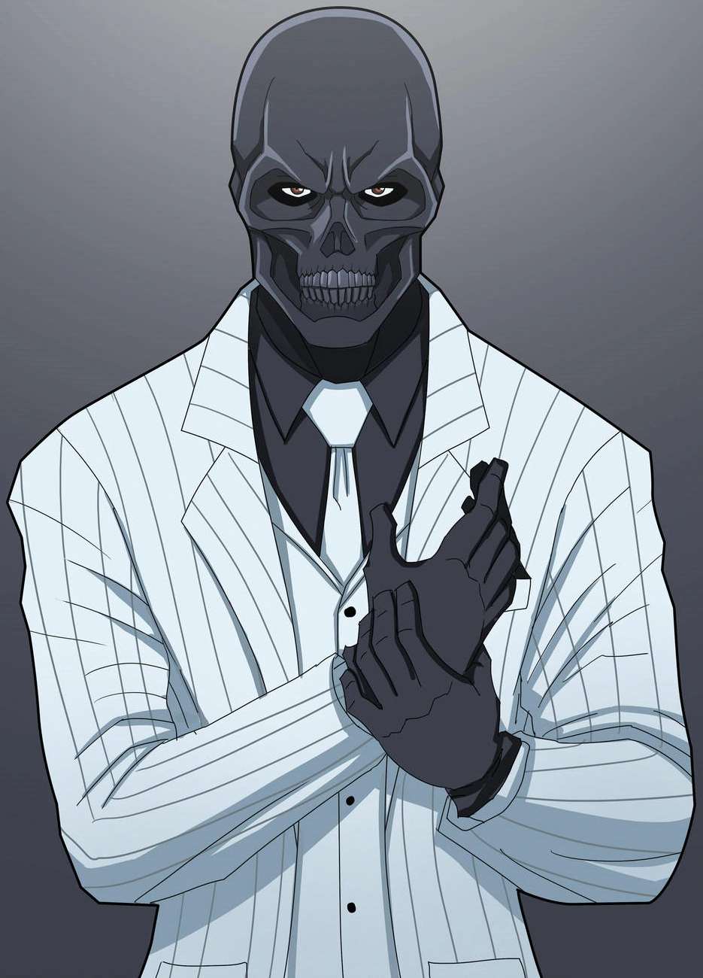
Notes:
Black mask

Slide 46

Notes:
Humpty dumpty

Slide 47
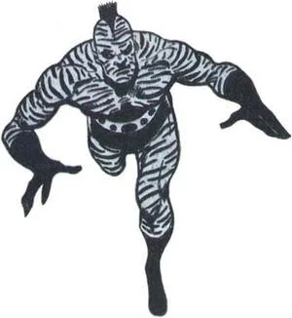
Notes:
Zebra man

Slide 48
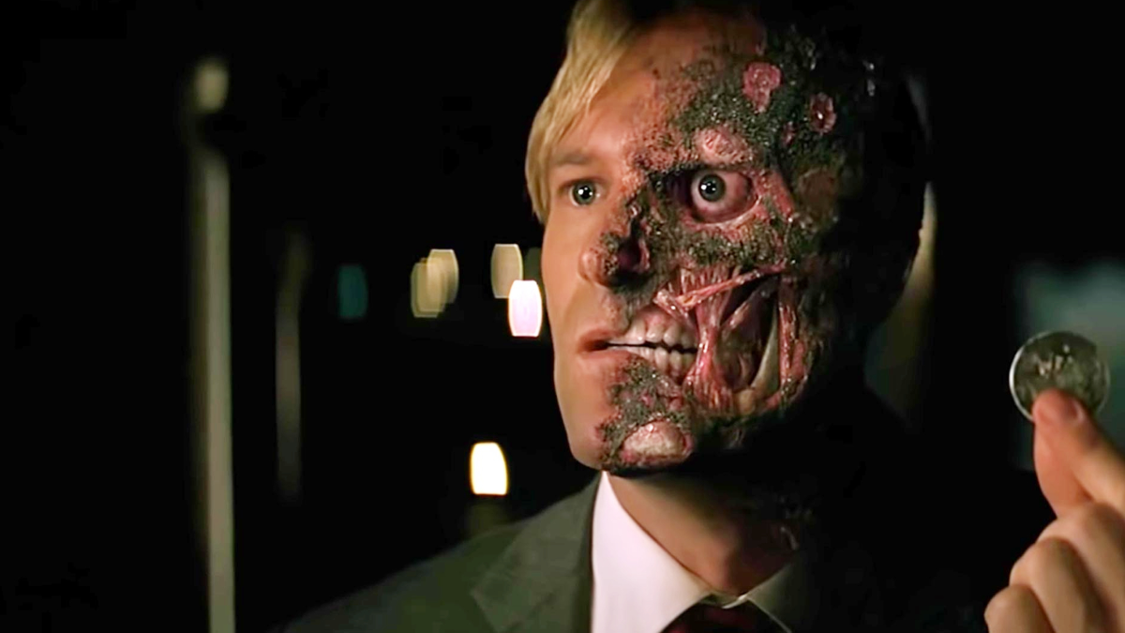
Notes:
Two face

Slide 49
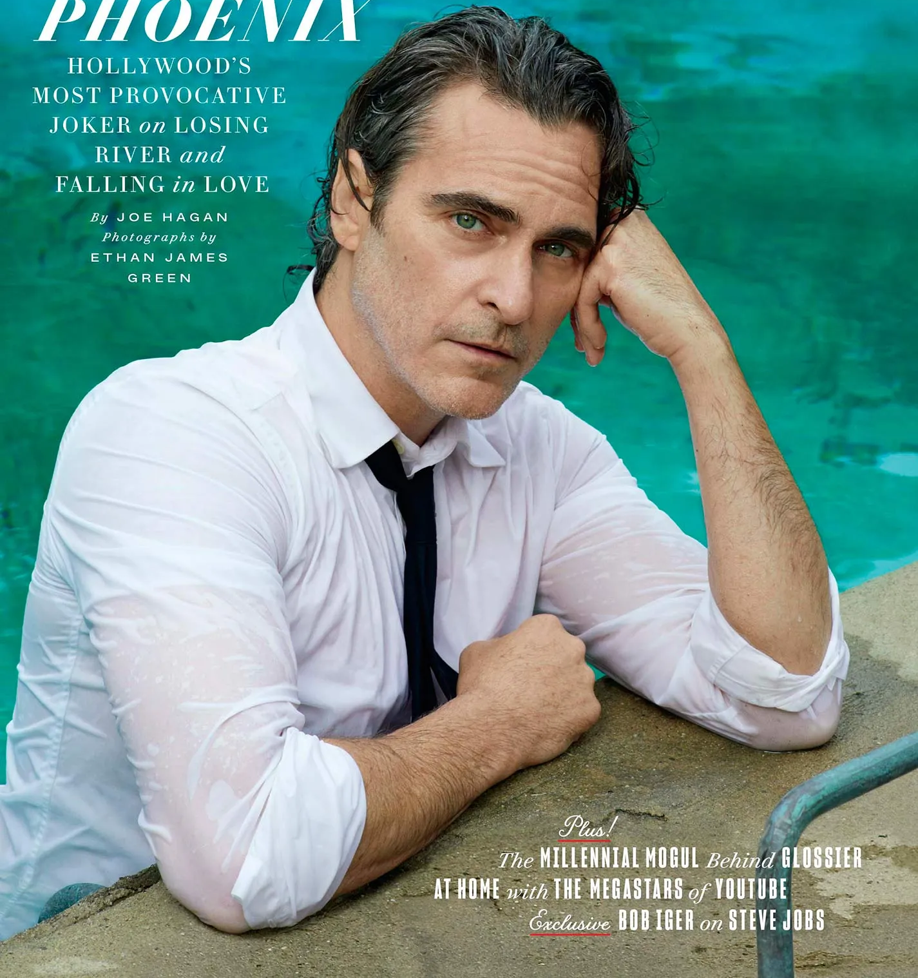
Notes:
Joaquin Phoenix

Slide 50
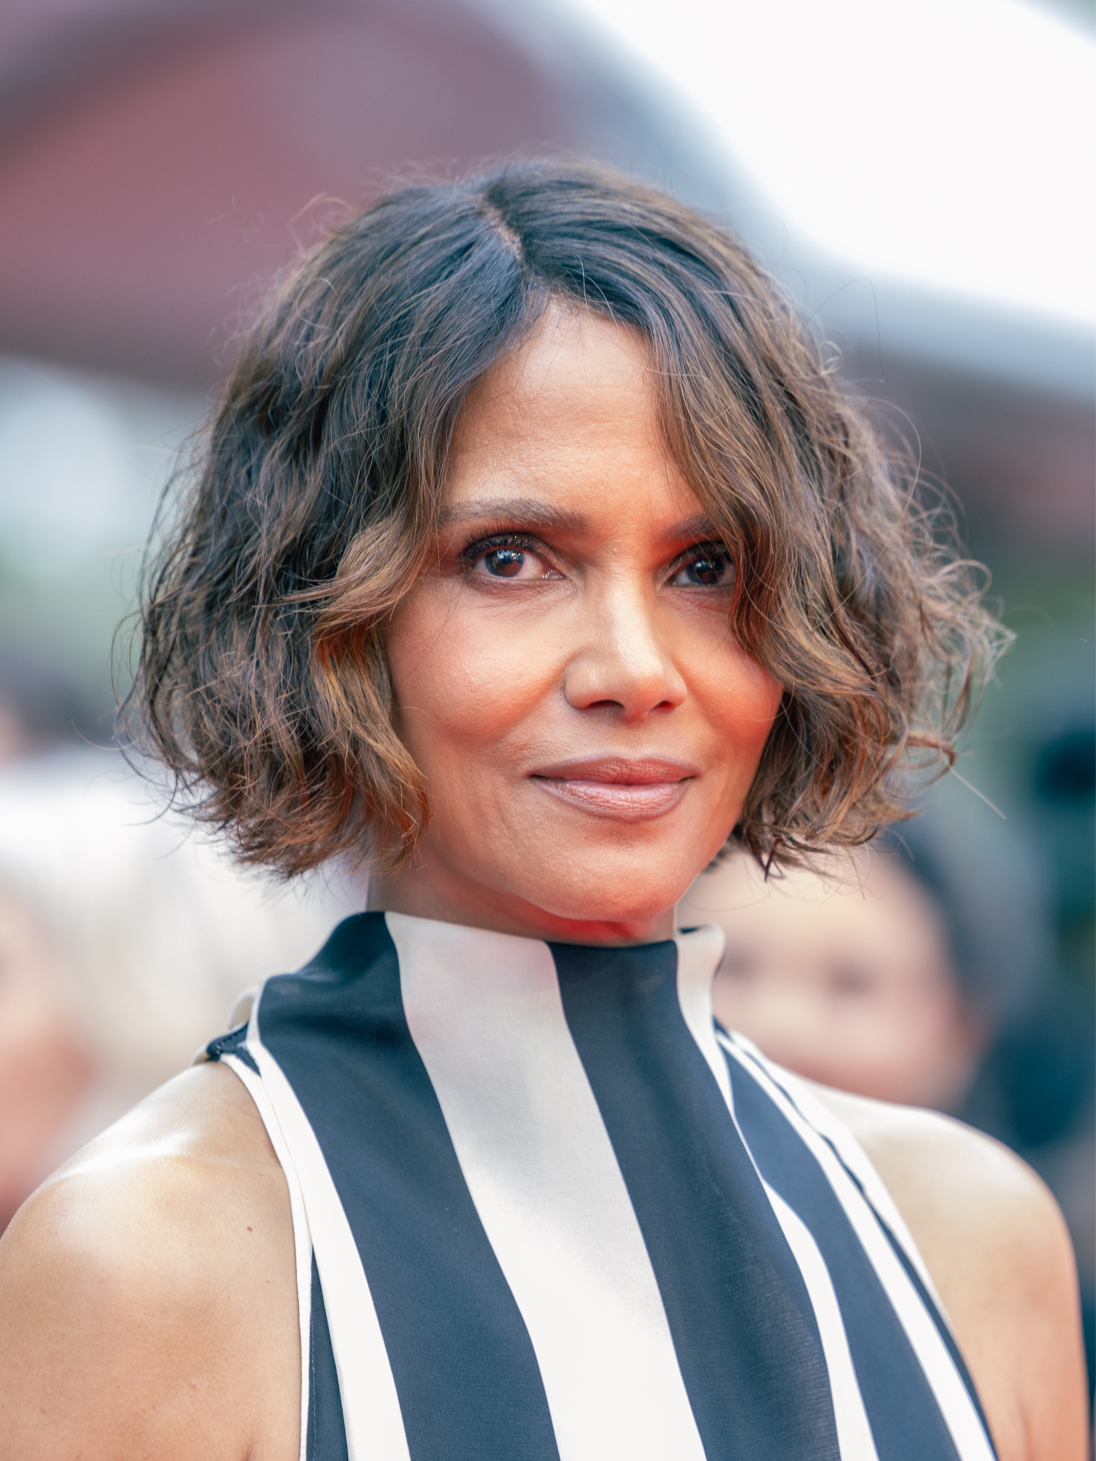
Notes:
Halle Berry

